Slide 1
Instructies vertaling
In deze PowerPoint vind je de teksten die we graag willen laten vertalen. Hierbij vragen we je rekening te houden met de volgende punten:
Vertaal de teksten direct in de bestaande tekstvakken.
Past een vertaling niet binnen het tekst vak, kies dan voor een passende alternatieve formulering.
Is dit niet mogelijk, plaats dan een opmerking bij de betreffende slide.
Vertaal ook de teksten in de afbeeldingen op slides 22 t/m 24, inclusief de teksten bij de iconen.
Bij vragen of onduidelijkheden graag direct contact opnemen, zodat we het proces vlot kunnen laten verlopen.

Slide 2
E-learning
Applying hygienic working practices
in PWN installations

Slide 3

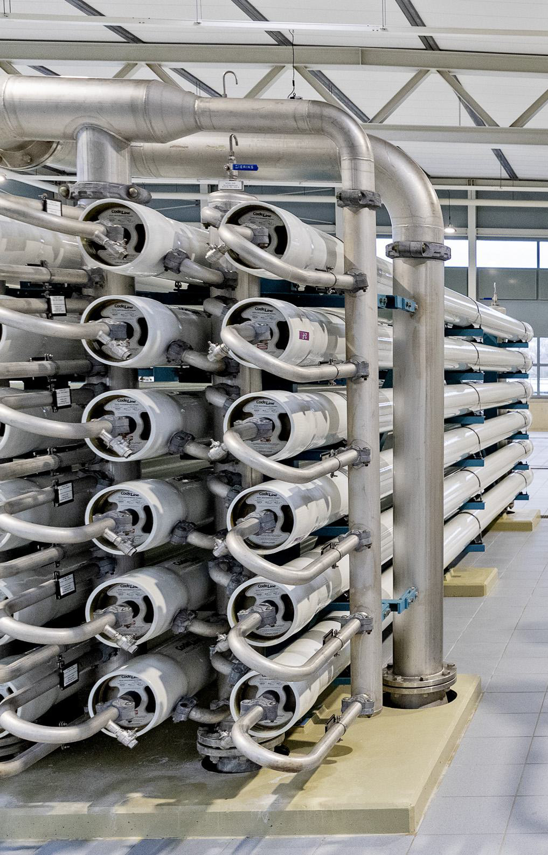
The content of the course
The course is a summary of the national hygiene code and our internal PWN policy.
You will learn about:
The need for this course
Company rules
Classification of purification plants
Hygienic zones New construction and Renovation projects
Test with 10 multiple-choice questions
If you answer 7 or more questions correctly, you have passed.
This e-learning includes audio information.
Therefore, turn on the sound.

Slide 4
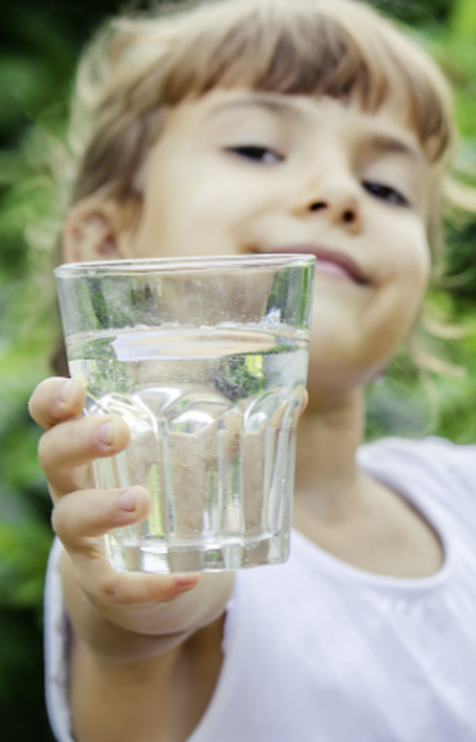
Why this course
Clean drinking water is of vital importance
No fewer than 825,000 connections (households and businesses) use PWN water on a daily basis.
The consequences of contamination in a (purification) plant affect a great many people.
Applying hygienic working practices is an absolute necessity.

Slide 5
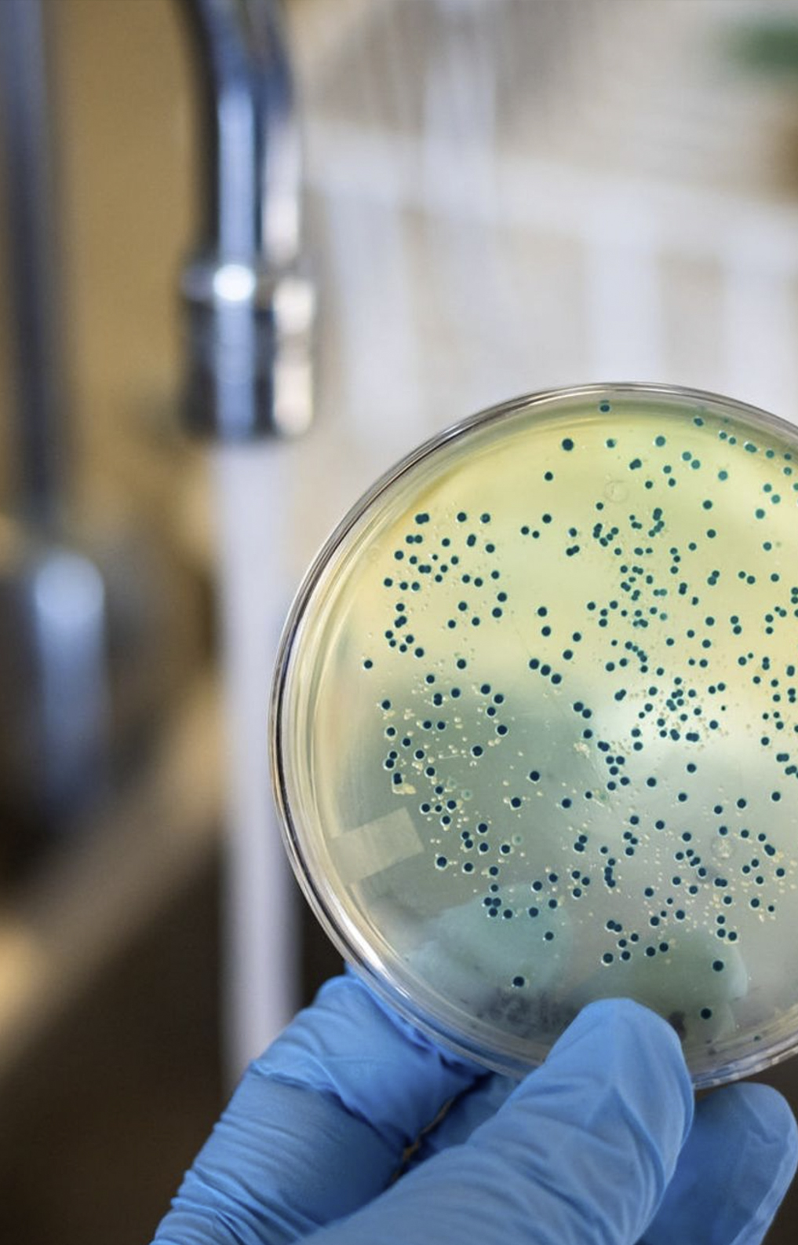
How can drinking water become contaminated?
Chemical:
By discharging into the intake water
Chemical contamination
Oil leaking from pumps
Using unclean materials
By placing tools, materials and/or equipment in open installations and/or pipe sections
Biological
Due to the intrusion of pests
Dirty water
Microbiological
Contaminated water ingress (can look clean)
Failing to apply hygienic working practices

Slide 6
Contamination can be chemical, biological or microbiological
This course is about microbiological contamination.
Apply hygienic working practices and prevent problems for hundreds of thousands of people.
What doesn't go in, doesn't have to be taken out

Slide 7

Company rules at our sites
Use access passes
Do not enter when you carry a (contagious) disease
Personal hygiene
Do not eat, drink or smoke during work
Adhere to hygiene zoning rules
Use of disinfectant is mandatory
Wear clean boots and clothing
Use clean tools brushed with disinfectant
Use PWN-approved equipment
A work plan and work permit is mandatory
Disinfect where necessary
Safety
Always
comes
first!

Slide 8
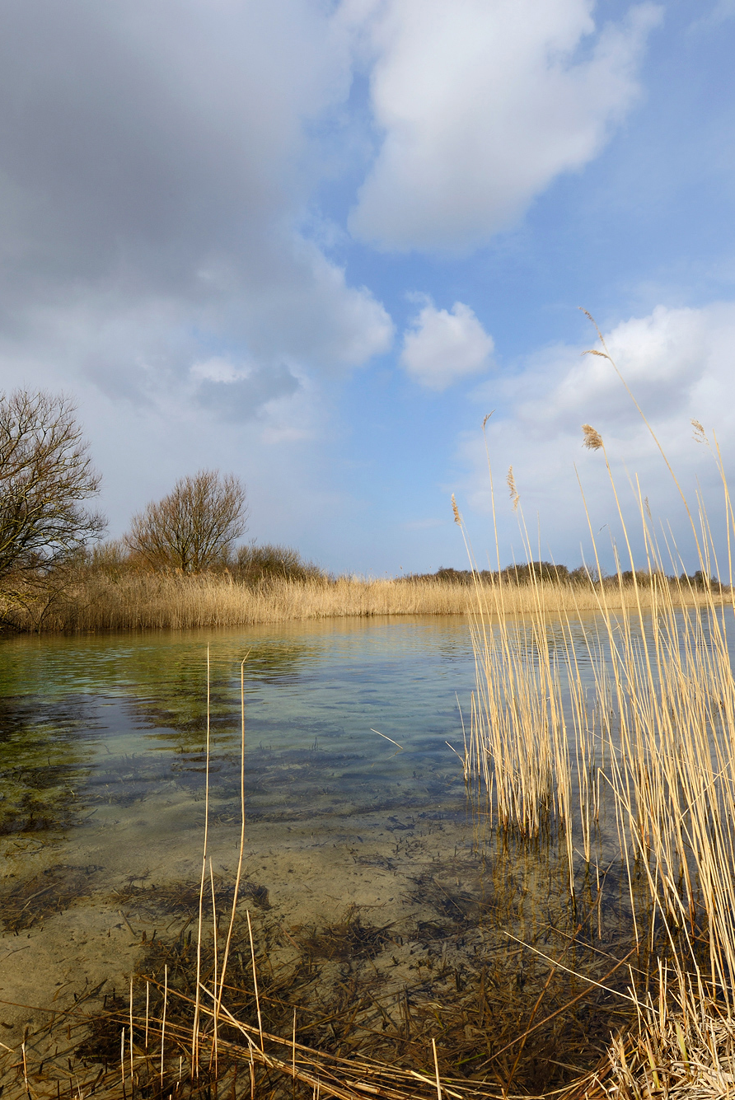
Company rules for infiltration areas
Prevent soil contamination
Do not place materials and tools directly on the ground
Prevent sand, soil and dirt from entering reclaimed water
Take no risks whatsoever, when it comes to drinking water

Slide 9
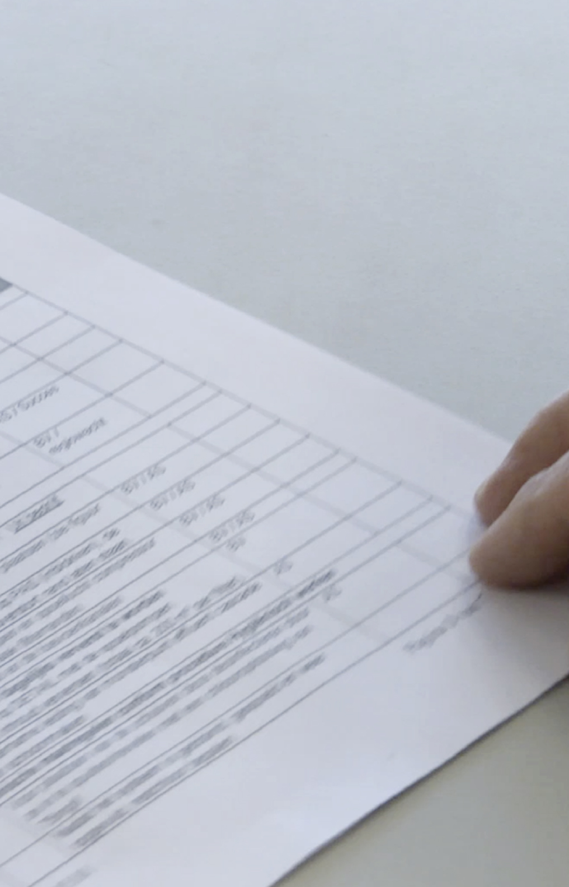
Work plan and work permits
A work permit is required at all times. The permit must be fully completed and signed.
We assess the need for a work plan for each job.
The work plan states, for example:
A general description of the activities
The relationship with other activities
Any points of attention and consequences
A step-by-step plan, including disinfection plan

Slide 10
Classification of purification phases – blue, orange and red
PWN purifies water step by step, from coarse to fine, ultimately achieving safe drinking water
The further along in the purification process your work is, the more severe the consequences of contamination. Therefore, always set up a hygiene zone within an installation.
Purification phases are divided into 3 categories:
Category blue
Raw water, has not yet been disinfected
Category orange
Has had some disinfection
Category red
Mainly disinfected or of drinking water quality

Slide 11
Category blue
Category orange
Category red
Raw water, no purification
Examples: basins, intake channels, raw water screens
No disinfection after completing your work
No control via sampling
Installation may be put back into operation immediately
Some purification
Examples: coagulation and sedimentation
Disinfection after completing your work
Post-control via sampling
Installation may be put back into operation immediately
Final purification phase or already of drinking water quality
Examples: drinking water reservoirs, entire PWN distribution network
Disinfection after completing your work
Post-control via sampling
Installation may only be put into operation after samples have been approved

Slide 12
Category blue
Category orange
Category red
Andijk Pumping Station
Basin, Rough water micro- and rotary screens, SIX
Flocculators, Sand filters, Ceramic micro-filtration
UV / hydrogen peroxide, Activated carbon filters, Clean water micro-screens
Princess Juliana Water Extraction Station (WJP)
Basin, Rough water rotary screens
Coagulation & sedimentation, Sand filters
Production company Jan Lagrand
UF filtration and HF filtration
Membrane purification I & II
Production company Jan Lagrand
UV / hydrogen peroxide, Activated carbon reactors
Pre-purification
Infiltration
Infiltration basins
Abstraction wells, Branches, Secondary pumping stations
Production company Bergen
Cascade, Sand filtration, UV post-disinfection, Mixing
Production company Wim Mensink
Softening, Cascade, Sand filtration, UV post-disinfection, Mixing

Slide 13
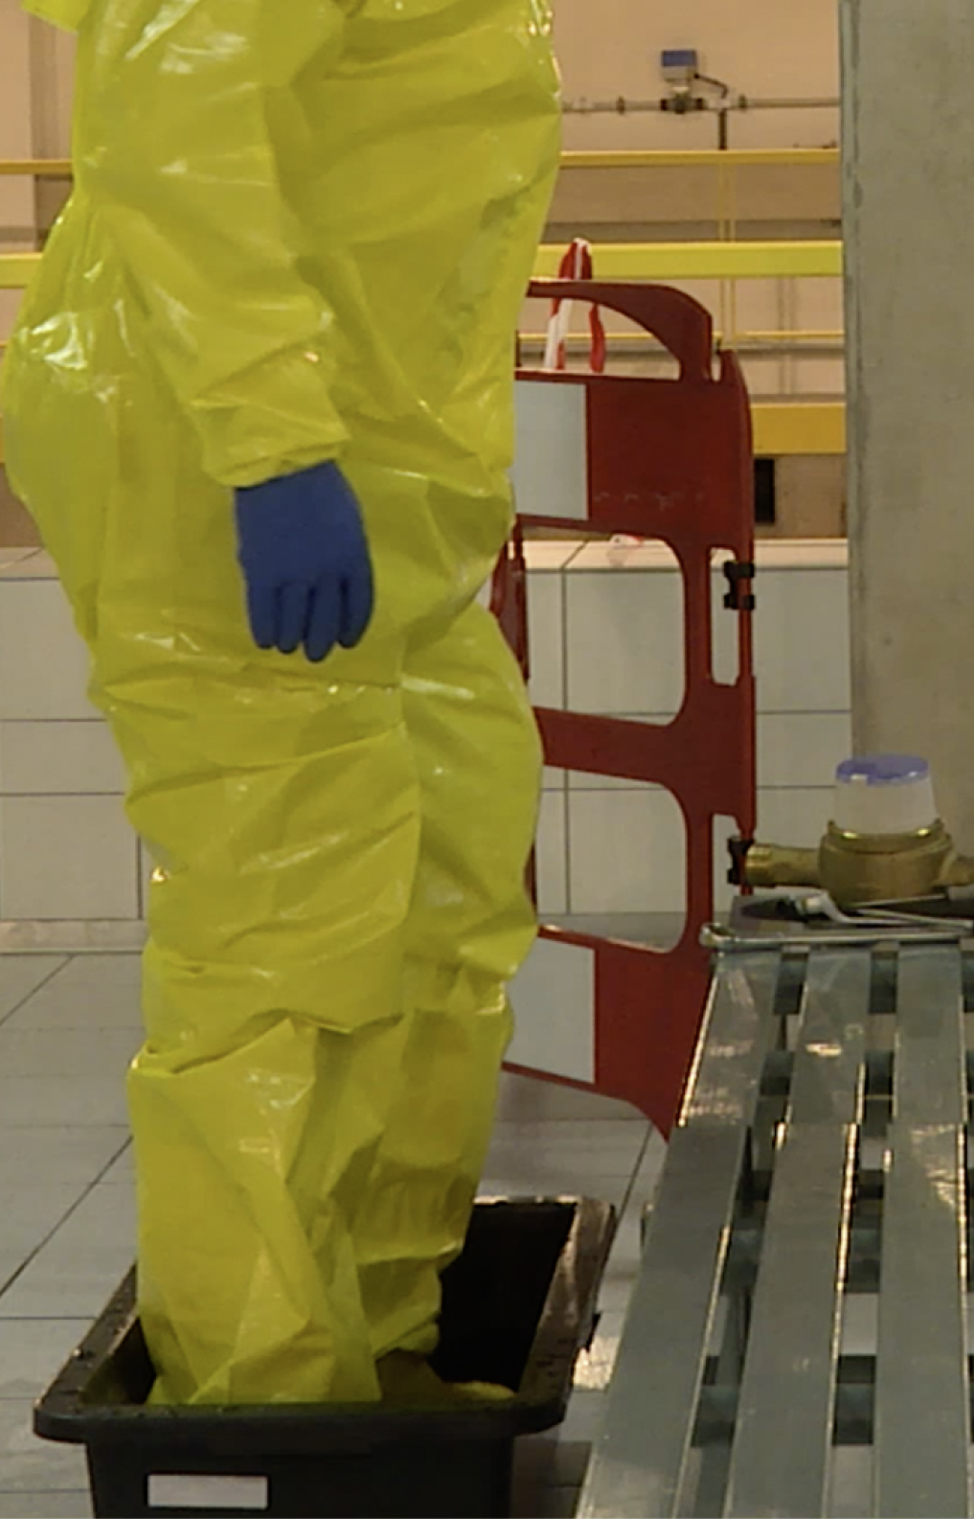
Disinfection after completing your work
No matter how tidy you work, there will always remain a risk of dust or dirt.
Disinfectants:
Chlorine bleach
35% hydrogen peroxide: used for the UF and HF membranes, because HF membranes are not chlorine resistant.
Hydrogen peroxide only at 3 sites: in UV/hydrogen peroxide installation in Andijk and Heemskerk & in HF membranes, as not chlorine resistant
Ensure to follow these rules:
Use proper personal protective equipment
Use the correct dosage: too little doesn't work, nor does too much.
Include disinfection plan in work plan. Any doubts? Please contact your PWN contact person.

Slide 14
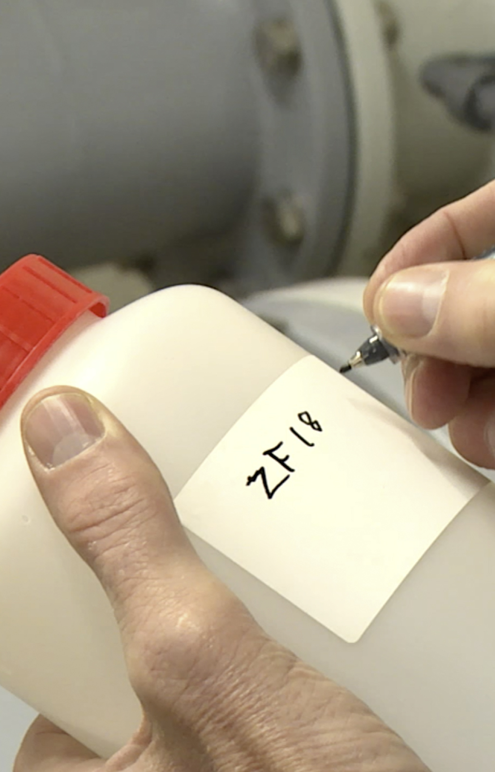
Control samples after completing your work and disinfecting
Within the orange and red categories, samples are always taken after you have completed your work.
Results follow within 1 to 2 days
Rejected? On average 5 days to complete new disinfection cycle

Slide 15
Apply hygienic working practices, always and everywhere
Wherever you work, you must always apply a clean and tidy approach in your work. Well into the project, you must also apply hygienic work practices, in addition to a tidy approach.
We repeat what that means.

Slide 16
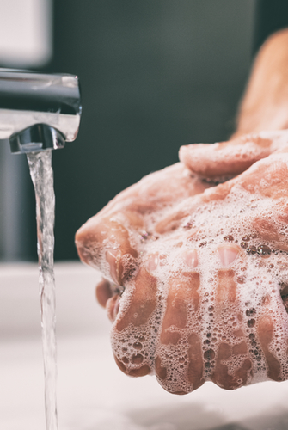
The following rules apply during demolition, new construction or renovation projects:
Personal hygiene
Clean and tidy workplace
Pictograms and warning signs
Hygienic zones

Slide 17
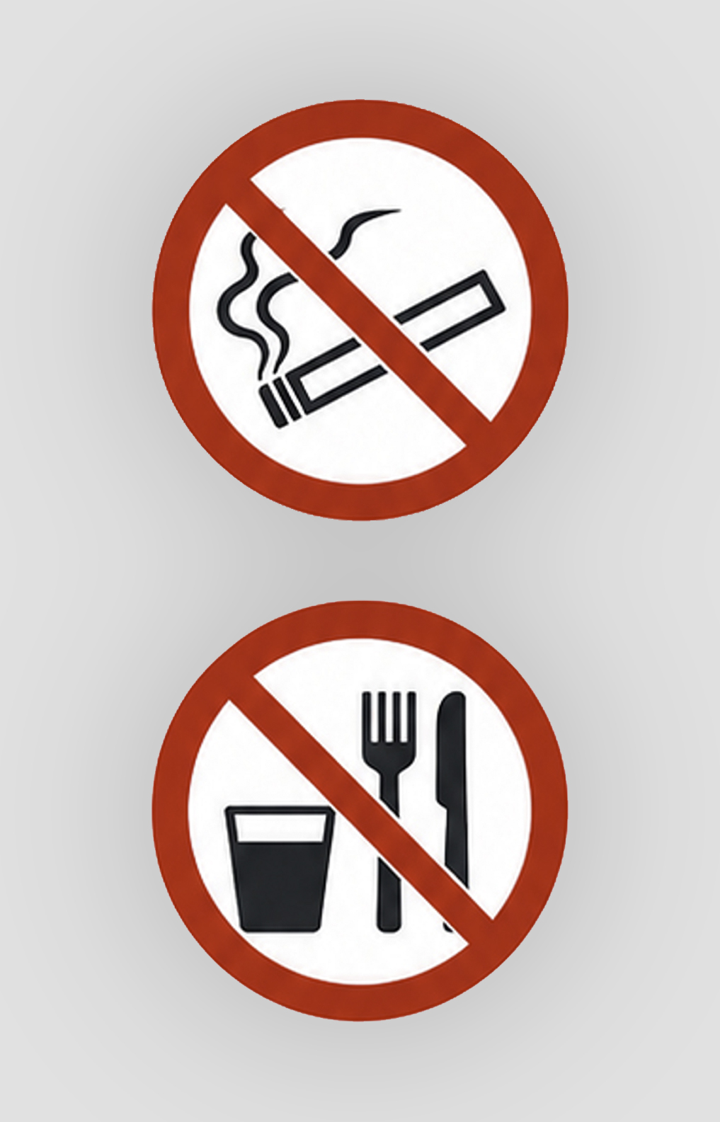
Personal hygiene
Do not eat, drink or smoke at your workplace
Wash your hands before you start your work and after each toilet visit.
Wear clean safety shoes
Wear clean work clothes

Slide 18
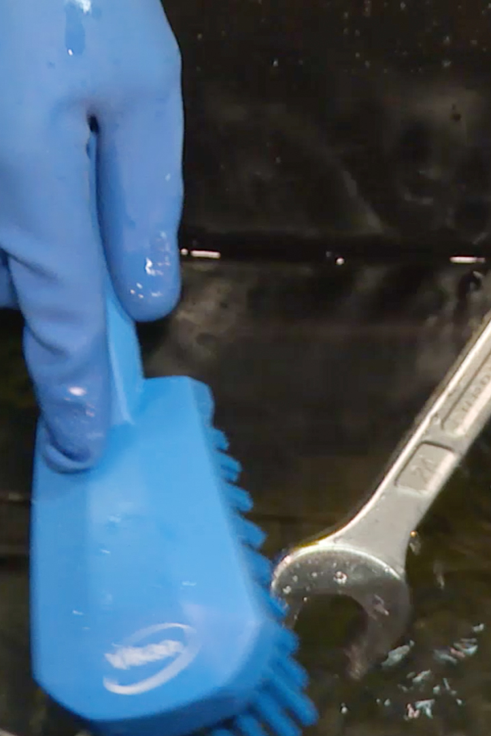
Clean and tidy workplace
Only bring the tools, materials and equipment that you need that day.
Do not place tools, materials or equipment in the installation or in open pipe sections.
At the end of your working day, tidy everything up neatly and leave your workspace clean and dust-free.
Use a brush with plastic bristles to disinfect tools.

Slide 19
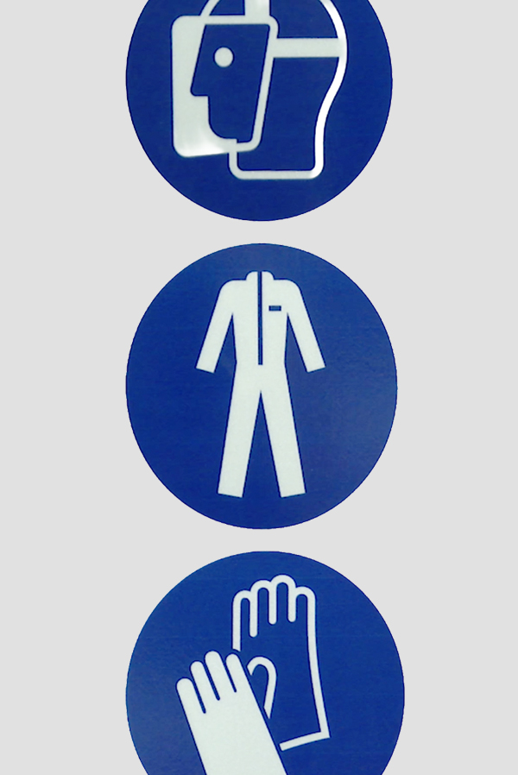
Pictograms and warning signs
Always pay attention to warning signs and pictograms. This is to ensure your own safety as well as that of others.
They are there for a reason, so do not ignore them!

Slide 20
Applying hygienic working practices
If you will be working in or on the installation during the project, the following rules apply with regard to hygienic working practices:
Do not eat, drink or smoke
Apply personal hygiene
Wear clean work clothes and footwear
Pay attention to warning signs and pictograms
Keep the workplace clean and tidy
Use clean tools and materials
Disinfect tools and materials before use
Take care of your safety and that of others
Clean up thoroughly after completing your work

Slide 21
Hygienic zones
These are zones in installations near open water where special requirements are imposed to reduce the risk of (re)contamination of the water, because this water is or will be of drinking water.

Slide 22
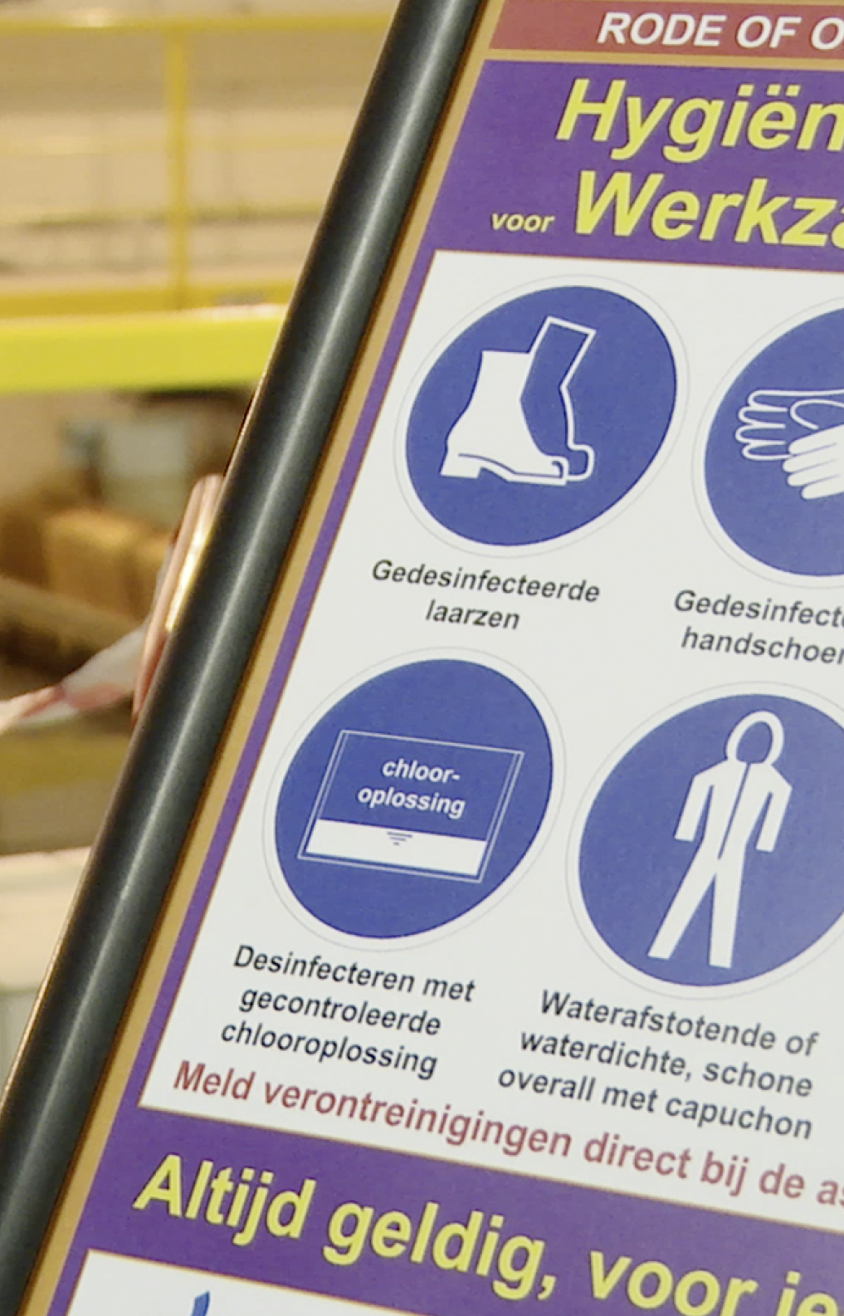
In new construction and renovation projects, we distinguish 3 hygienic zones:
Green zone: all areas in which any type of work may be carried out.
Red zone: area in which drilling, grinding or sawing is prohibited because installation parts or pipe sections are exposed for assembly.
Purple zone: Applies in the event of work on installation parts or pipe sections through which drinking water has already flowed or through which drinking water will flow immediately following the work.

Slide 23
Green Zone
All areas
In the Green Zone (all areas):
Wear clean safety shoes
Wear clean work clothes
Tidy up at the end of the working day
No eating and drinking
No smoking
Pipes must be capped off
Do not place tools or materials in the pipes.
Wear clean work clothes
Wear clean safety shoes
Tidy up at the end of the working day
Cap off pipe sections
No eating and drinking
No smoking
Do not place objects in the pipes
Report contamination directly to the supervisor.
Applicable to all, at all times

Slide 24
Red Zone
Water-bearing space
In the Red Zone (water-bearing area with open installation parts or pipe sections):
Wear clean work clothes
Tidy up at the end of the working day
No eating and drinking
No smoking
Prevent objects falling from clothing
Pipes must be capped off
No drilling, grinding and sawing
Do not place tools or materials in the pipes.
Wear clean work clothes
Wear clean safety shoes
Tidy up at the end of the working day
Cap off pipe sections
No eating and drinking
No smoking
Do not place objects in pipes
No drilling, grinding and sawing
Report contamination directly to the supervisor.
Applicable to all, at all times

Slide 25
Purple Zone
Hygienic zone prior to start of work
When work is carried out on these installations and an “open connection” is created, the area surrounding that open connection must be locally and temporarily designated as a Purple Zone.
The following rules will be listed on the purple information signs:
Wear disinfected boots
Wear disinfected gloves
No eating and drinking
Disinfect using a controlled peroxide solution
Wear water-repellent or waterproof, clean hooded overalls
Prevent objects falling from clothing
Since there are open pipe sections in a purple zone and because no dust must enter these, the purple zone is always surrounded by a red zone. Therefore, drilling, grinding or sawing is not permitted there.
Wear disinfected boots
Wear disinfected gloves
No eating and drinking
Disinfect using a controlled peroxide solution
Wear water-repellent or waterproof, clean hooded overalls
Prevent objects falling from clothing
Report contamination directly to the supervisor.
Applicable to all, at all times

Slide 26
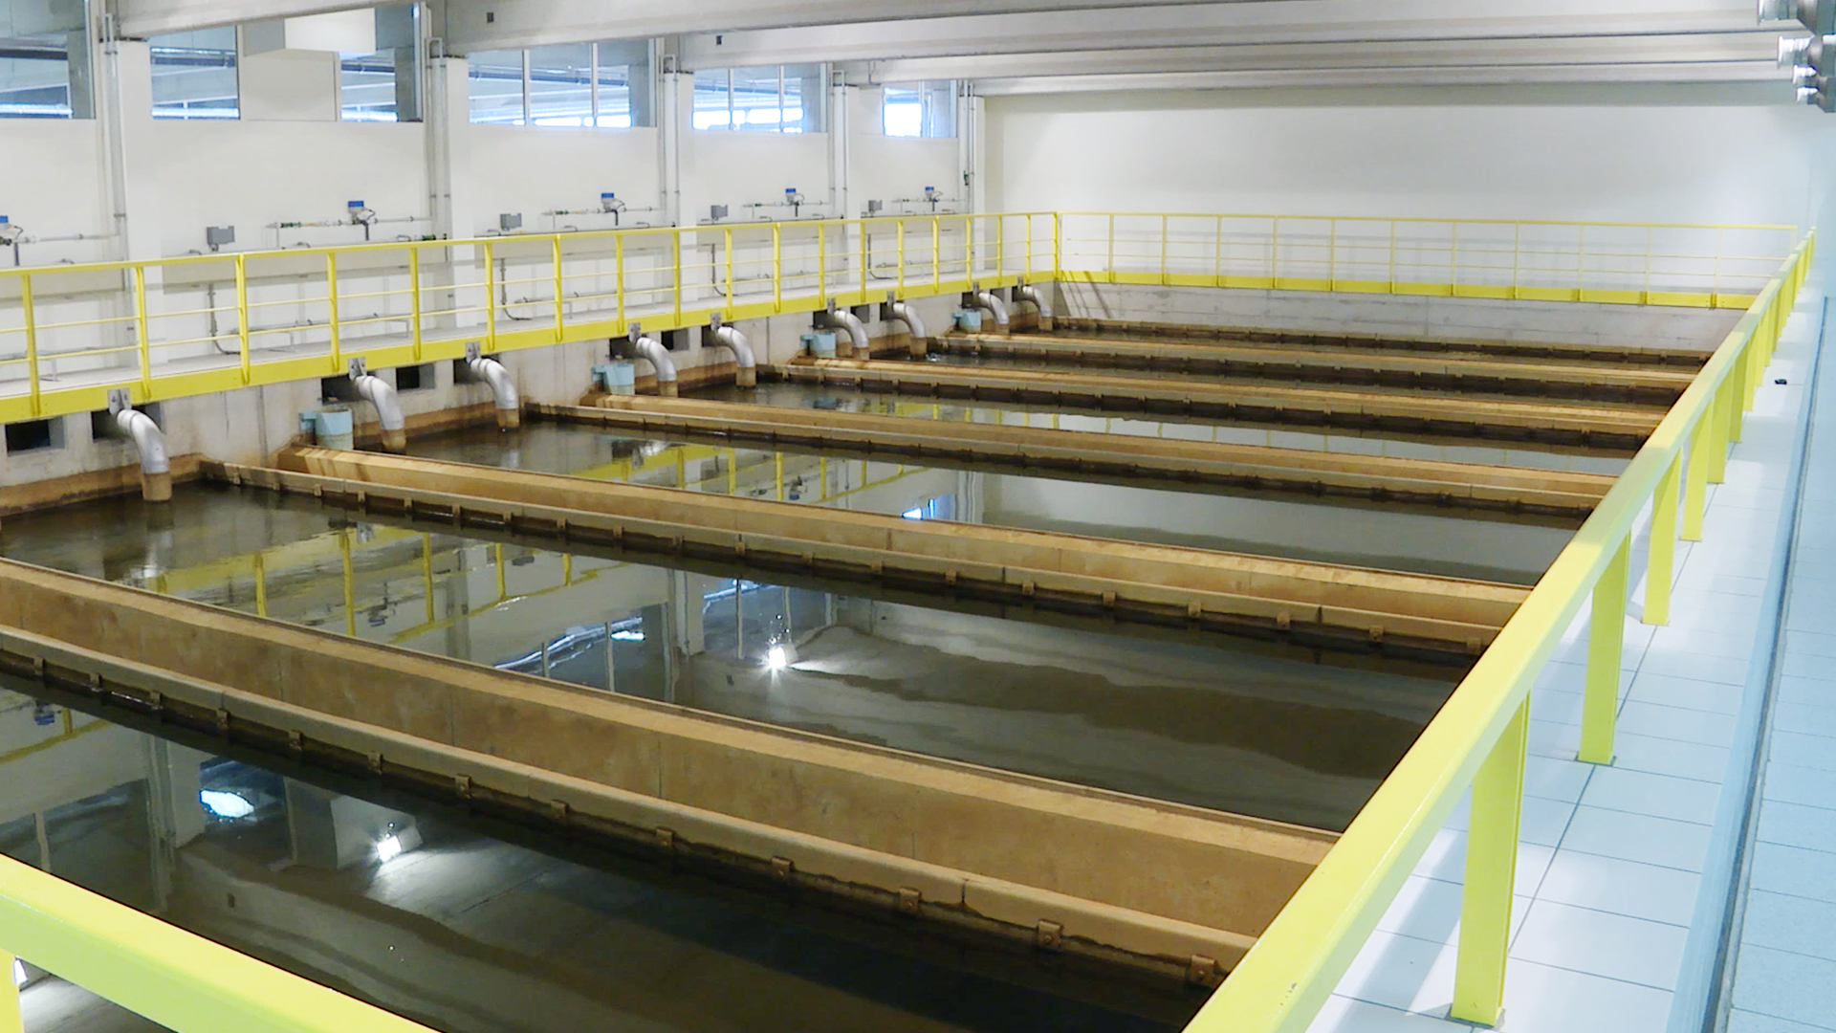
A final summary

Slide 27
Classification of purification phases – blue, orange and red
Purification phases are divided into 3 categories:
Category blue
Raw water, has not yet been disinfected
Category orange
Has had some disinfection
Category red
Mainly disinfected or of drinking water quality

Slide 28
Category blue
Category orange
Category red
Raw water, no purification
Examples: basins, intake channels, raw water screens
No disinfection after completing your work
No control via sampling
Installation may be put back into operation immediately
Some purification
Examples: coagulation and sedimentation
Disinfection after completing your work
Post-control via sampling
Installation may be put back into operation immediately
Final purification phase or already of drinking water quality
Examples: drinking water reservoirs, entire PWN distribution network
Disinfection after completing your work
Post-control via sampling
Installation may only be put into operation after samples have been approved

Slide 29
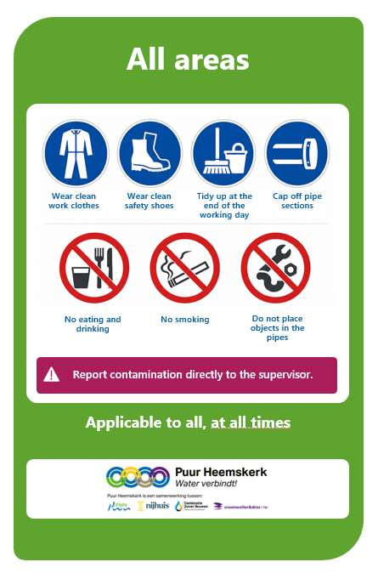
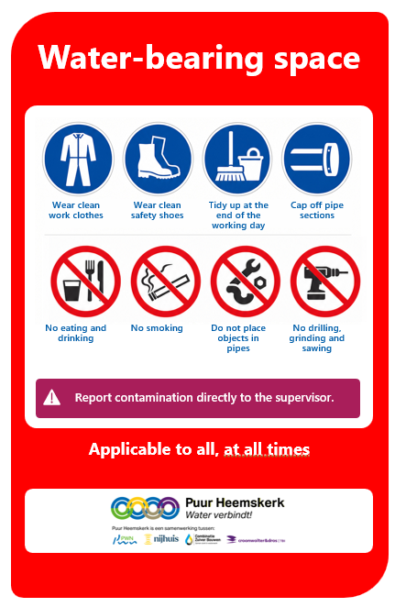
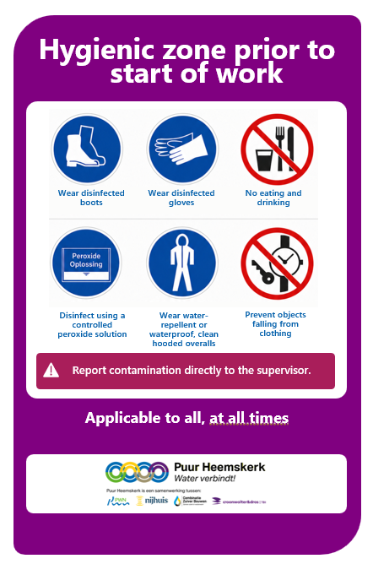
Within PWN, we work with hygienic zones. You can recognise these by a green, red or purple sign.

Slide 30
Apply clean and hygienic working practices; this prevents unnecessary delays in the completion of your work.
Rejection means a delay in the work.

Slide 31
Repeated violation of the rules may result in being denied access to the work.
We are open to tips and suggestions for improvement.

Slide 32
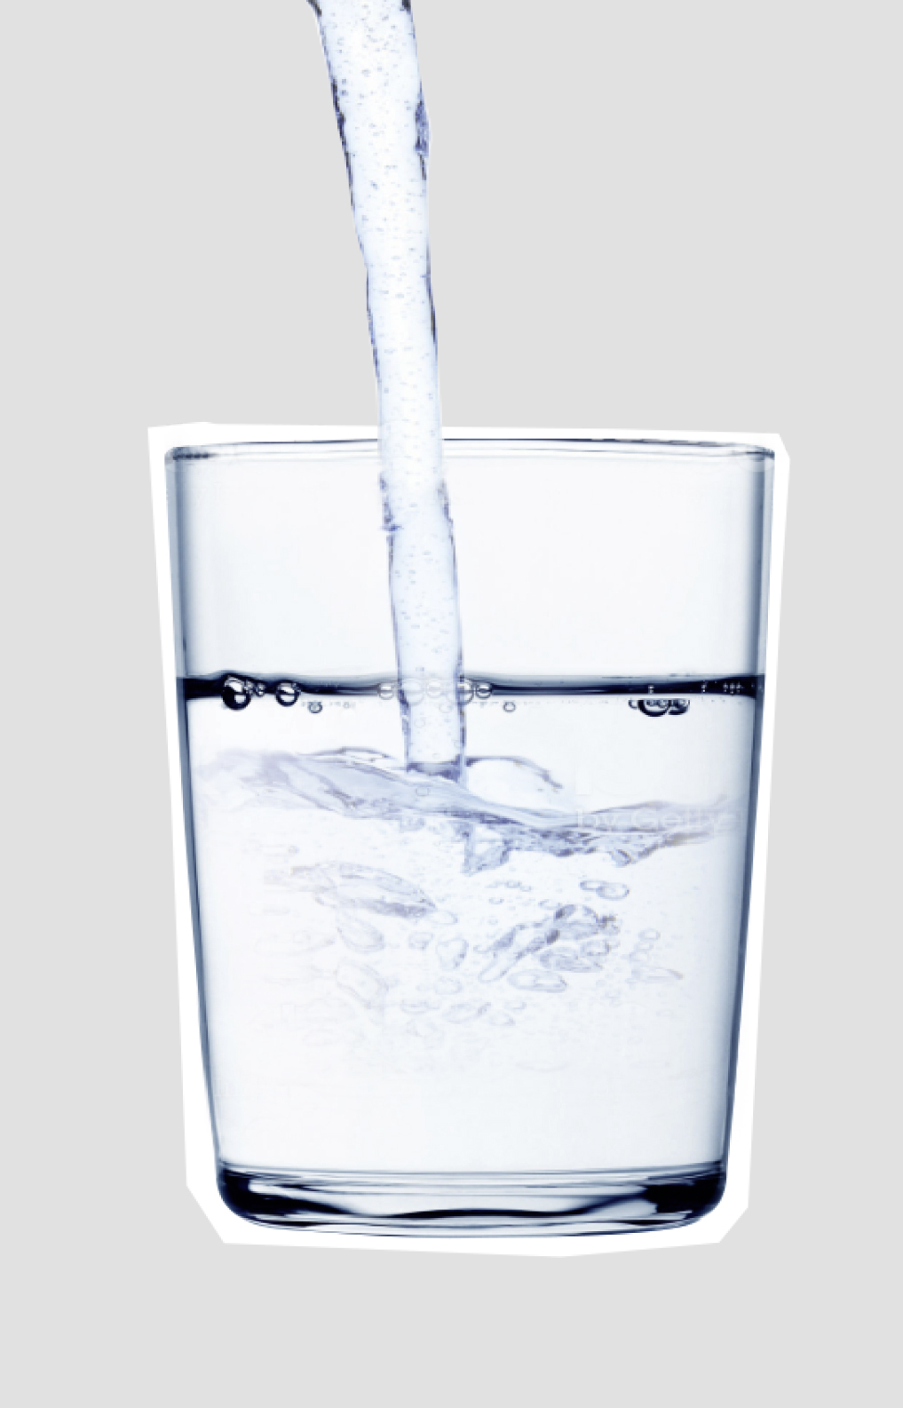
Together we ensure the workplace is clean and safe
Thank you for your attention whilst watching this course.
You will now be presented with 10 multiple-choice questions. You must score at least 7 out of 10 to pass.
Good luck with the questions.
We look forward to seeing you at one of our sites.

Slide 33
Thank you for
your attention

Slide 34
Instructies vertaling
In deze PowerPoint vind je de teksten die we graag willen laten vertalen. Hierbij vragen we je rekening te houden met de volgende punten:
Vertaal de teksten direct in de bestaande tekstvakken.
Past een vertaling niet binnen het tekst vak, kies dan voor een passende alternatieve formulering.
Is dit niet mogelijk, plaats dan een opmerking bij de betreffende slide.
Vertaal ook de teksten in de afbeeldingen op slides 22 t/m 24, inclusief de teksten bij de iconen.
Bij vragen of onduidelijkheden graag direct contact opnemen, zodat we het proces vlot kunnen laten verlopen.

